Slide 1
DATABASE SYSTEMS ENGINEERING AND DISTRIBUTED BACKEND DEVELOPMENT (25CS1302E)
Y25 | 2026-2027 | Trimester 4 | Project Review 2
Multi-Vendor Campus Marketplace
& Delivery Platform
A unified web platform connecting campus vendors, students, and delivery agents
Sec No: 10 Team No: 9 Guide: __________________
V. Bhardwaj
P. Uday
A. Chaitanya
2520090182
2520090089
2520090094

Slide 2
REVIEW 2
Problem Statement
1
Fragmented vendor access
2
No unified digital channel
Students reach campus vendors — stationery, cafeteria, print center, grocery — separately through calls or in-person visits.
There is no single platform to browse, compare, and order from multiple vendors together.
3
Operational inefficiency
4
Limited vendor resources
This causes long wait times, order mismanagement, and missed revenue for small vendors.
Individual vendors lack the resources or expertise to build their own e-commerce solutions.
DBSE & DBD — Team 9
2

Slide 3
REVIEW 2
Objectives
1
Build a unified multi-vendor marketplace for campus goods and services
2
Enable one shared cart and checkout across multiple vendors
3
Provide role-based access for students, vendors, and delivery agents
4
Support real-time order tracking and secure online payments
5
Streamline vendor operations and reduce order fulfillment time
6
Give vendors sales insight through an analytics dashboard
DBSE & DBD — Team 9
3

Slide 4
REVIEW 2
Proposed System
A web-based platform where multiple campus vendors list and manage their own products and services
Students browse, compare, and place orders across vendors through a single unified cart and checkout
Dedicated delivery-agent module handles pickup and drop-off of orders within the campus
Distributed, database-driven backend keeps data consistent across concurrent vendor transactions
Scalable order processing with efficient real-time inventory synchronization
DBSE & DBD — Team 9
4

Slide 5
REVIEW 2
System Architecture
Client Layer
Application Layer
Data Layer
React.js Web App
(Student / Vendor / Delivery UI)
Node.js + Express.js
REST API Server
MongoDB / MySQL
Distributed Database
Supporting Services (connected to Application Layer)
Payment Gateway
(Razorpay / Stripe)
Notification Service
(Firebase Cloud Messaging)
Auth Service
(JWT Role-based Access)
Three-tier architecture: presentation, application logic, and distributed data storage communicate over secure REST APIs.
DBSE & DBD — Team 9
5

Slide 6
REVIEW 2
Modules / Functionalities
1
2
3
User Module
Vendor Module
Cart & Order Module
Registration, login, and role-based access for students, vendors, delivery agents
Product/service listing, inventory and order management
Unified multi-vendor cart, checkout, and order lifecycle
4
5
6
Delivery Module
Payment Module
Analytics Module
Agent assignment, pickup/drop-off, and status tracking
Secure payment gateway integration and transaction records
Sales dashboard and insights for vendors and admin
DBSE & DBD — Team 9
6

Slide 7
REVIEW 2
Frontend Design
Home Page
Login / Registration
Vendor listing with search and category filters
Role selection for student, vendor, or delivery agent
Forms
Dashboard
Product listing form, order form, delivery details form
Order history, vendor sales view, delivery task list
DBSE & DBD — Team 9
7

Slide 8
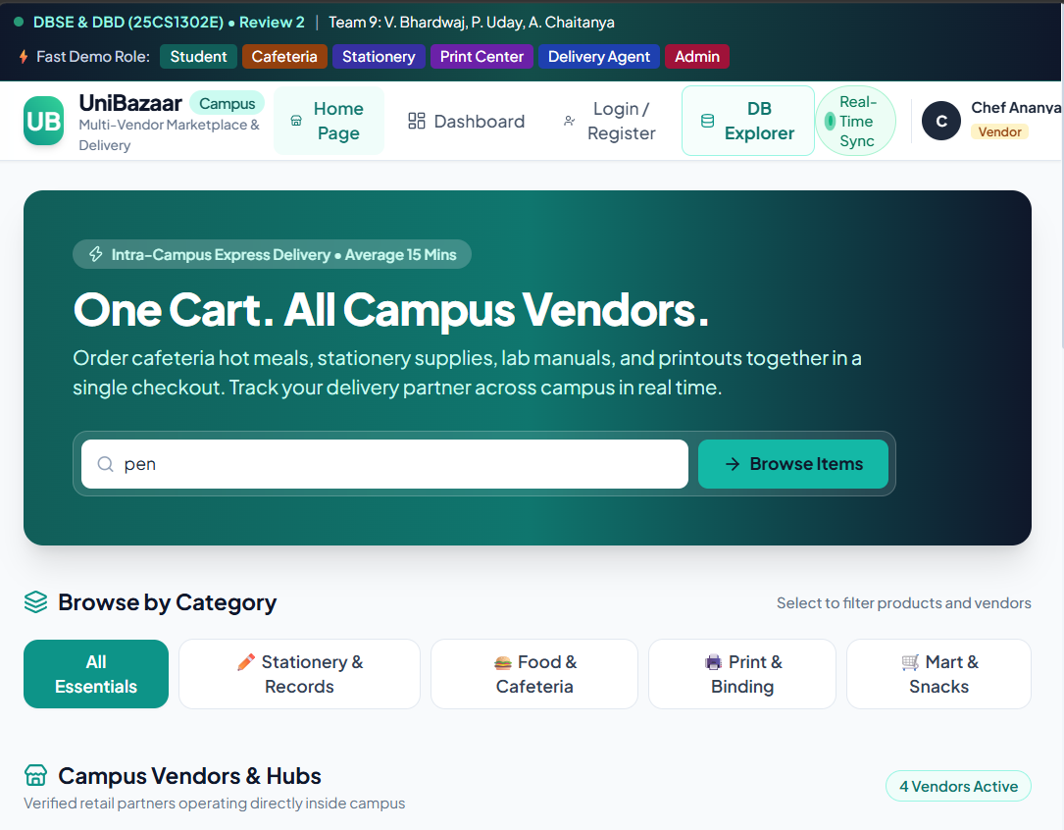
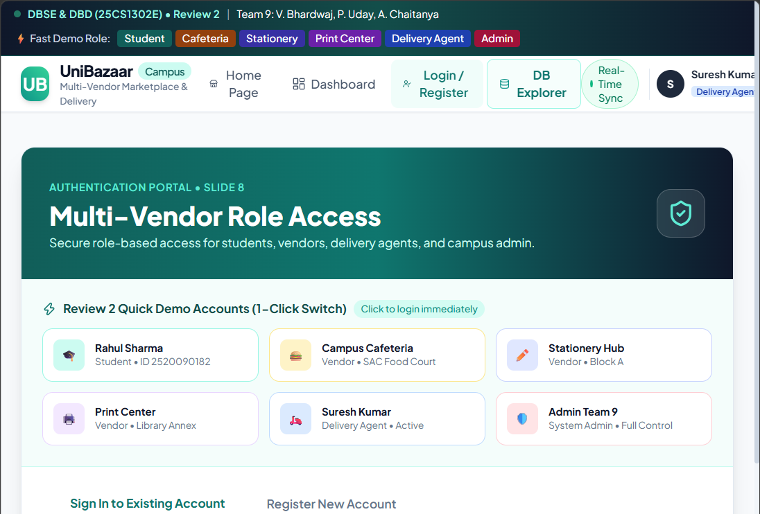
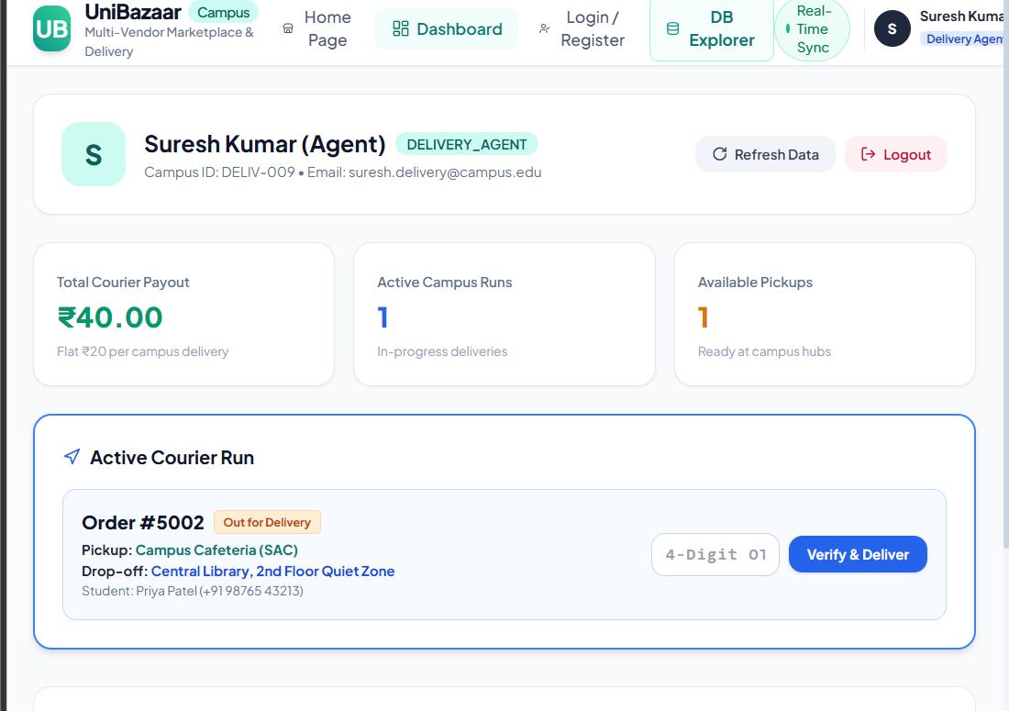
REVIEW 2
Frontend Implementation — Screenshots
⌘
⌘
⌘
Screenshot to be inserted
Screenshot to be inserted
Screenshot to be inserted
Home Page
Login / Registration
Dashboard
Note: Replace placeholders with live application screenshots before submission — every screen shown must reflect actual working progress.
DBSE & DBD — Team 9
8

Slide 9
REVIEW 2
Database Design
Core entities: User, Vendor, Product, Order, OrderItem, Delivery, Payment
Relational schema normalized up to 3NF to minimize data redundancy
Foreign-key relationships link orders to users, vendors, and products
Distributed database approach supports concurrent multi-vendor transactions
Indexing on frequently queried fields (user_id, vendor_id, order_id) for fast retrieval
DBSE & DBD — Team 9
9

Slide 10
REVIEW 2
ER Diagram
USER
VENDOR
DELIVERY
AGENT
places
lists
assigned
ORDER
contains
ORDER ITEM
for
PRODUCT
DELIVERY
fulfilled by
generates
PAYMENT
DBSE & DBD — Team 9
10

Slide 11
REVIEW 2
Database Tables / Schema
Table | Key Fields
Users | user_id (PK), name, email, role, password_hash
Vendors | vendor_id (PK), name, category, location
Products | product_id (PK), vendor_id (FK), name, price, stock
Orders | order_id (PK), user_id (FK), status, total_amount, created_at
OrderItems | order_item_id (PK), order_id (FK), product_id (FK), quantity
Delivery | delivery_id (PK), order_id (FK), agent_id (FK), status
Payments | payment_id (PK), order_id (FK), amount, method, status
DBSE & DBD — Team 9
11

Slide 12
REVIEW 2
Sample Database Records
Table: Products
product_id | name | vendor | price (₹) | stock
101 | Notebook (200pg) | Stationery Hub | 45 | 120
102 | Veg Meal Combo | Campus Cafeteria | 60 | 40
103 | Printout (B/W) | Print Center | 2 | 500
Table: Orders
order_id | user_id | status | total_amount (₹) | created_at
5001 | 2001 | Delivered | 107 | 2026-09-02 12:41
5002 | 2004 | Preparing | 60 | 2026-09-03 09:15
Sample data shown for illustration; actual values will be populated from the working database during the demo.
DBSE & DBD — Team 9
12

Slide 13
REVIEW 2
Current Progress
Requirement analysis & abstract
DONE
ER diagram & schema design
DONE
UI wireframes (home, login, dashboard)
DONE
Backend REST API development
IN PROGRESS
Vendor & product modules
IN PROGRESS
Payment gateway integration
PENDING
DBSE & DBD — Team 9
13

Slide 14
REVIEW 2
Challenges / Issues Faced
Handling concurrent orders placed across multiple vendors without data conflicts
Designing a schema that cleanly supports multi-vendor, multi-item orders
Building real-time logic to assign the nearest available delivery agent
Ensuring secure, role-based access control across student, vendor, and agent roles
Keeping inventory synchronized in real time as orders are placed and updated
DBSE & DBD — Team 9
14

Slide 15
REVIEW 2
Future Work
Complete remaining backend APIs and integrate the payment gateway
Implement real-time order and delivery notifications
Build the vendor-facing analytics and sales dashboard
Carry out unit, integration, and user-acceptance testing
Deploy the platform for a pilot run within the campus
DBSE & DBD — Team 9
15

Slide 16
CONCLUSION
Bridging Campus Vendors and Students, Digitally
The Multi-Vendor Campus Marketplace & Delivery Platform unifies fragmented vendor access into one convenient, reliable system
It gives students a single place to browse, order, and track purchases across every campus vendor
A distributed, database-driven backend keeps the platform consistent, scalable, and ready to grow
The result: greater convenience for students and stronger visibility and revenue for campus vendors
Thank You | Questions & Discussion
DBSE & DBD — Team 9
16

